Slide 1
More Details about the Mining Difficulty

Slide 2
What is the current target hash value?
How to calculate the mining difficulty?

Slide 3
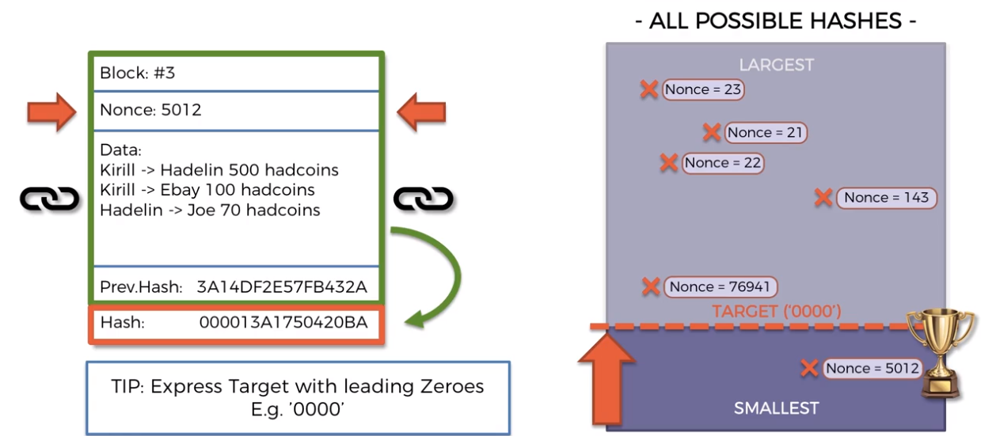
Question 1 What is the current target hash value?

Slide 4
The target means to use or generate a leading zeros in the resulted hash by changing the nonce value.
The previous figure is extremely disproportionate.
It looks like by setting a target of four leading zeros we are reducing the pool size of the valid pool size to about a quarter of the total.

Slide 5
In a hexadecimal number if we request one leading zero in the hash value then we are going to effectively reduce the pool size by 16 times.
If we request two leading zeros the valid area will be reduced to 1/16*1/16, If we request three leading zeros the area (valid hashes) will be 1/16*1/16*1/16, leading to a very small area of valid hashes.
It would be even invisible on the previous figure if we tried to plot the valid area of hashes for 4 leading zeros.

Slide 6
In a decimal number, lets assume we have:
a number of five digits. xxxxx
a number of five digits BUT the first one has to be a leading zero, then we have four digits.0xxxx
So in the first case, we have from 0 to 99,999➔ 100,000 options.
In the second case, we have from 0 to 9999➔ only 10,000 options.
By requesting one leading zero we're effectively reducing the pool size to 10000/100000 = 1/10.
In a hexadecimal number every digit can have 16 values.
So every leading zero is reducing the pool size to 1/16.
In reality even one leading zero is going to significantly reduce our options for a valid hash.
From the previous figure it looks like if we pick any random number in our random nonce, then we will have like a 25 percent chance of getting a golden hash.
But in reality it's much less.

Slide 7
Let us assume that this is the current target.
The focus will be on the leading zeros the rest is not going to make much of a difference compared to leading zeros.
What can we get from 18 leading zeros??.
You know we already saw what 4 leading 0’s feels like what about 18 leading zeros?.
How to calculate the probability of getting a golden nonce? Or if we randomly pick a nonce what is the probability that it will be a golden nonce?.
How do we calculate the problem?.
First, How many hexadecimal possible combinations are there in a number of 64-digit?

Slide 8
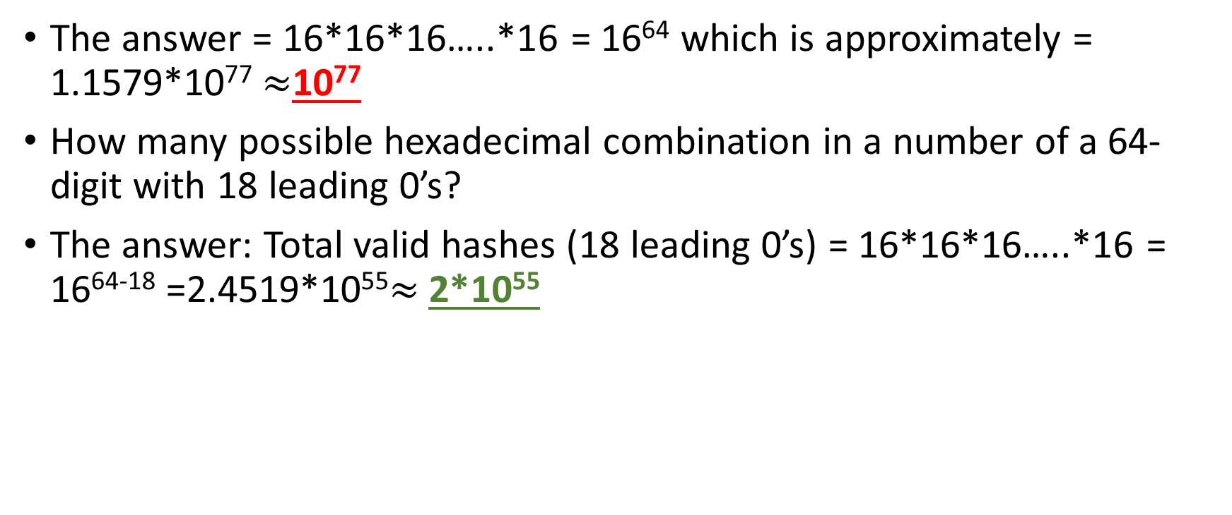
The answer = 16*16*16…..*16 = 16⁶⁴ which is approximately = 1.1579*10⁷⁷ $≈$10⁷⁷
How many possible hexadecimal combination in a number of a 64-digit with 18 leading 0’s?
The answer: Total valid hashes (18 leading 0’s) = 16*16*16…..*16 = 16⁶⁴⁻¹⁸ =2.4519*10⁵⁵$≈$2*10⁵⁵

Slide 9
The big pool of available combinations is 10*⁷⁷
While the restricted pool of valid combinations is 2*10⁵⁵ which we aim to find by using the golden nonce.
2*10⁵⁵ looks like a huge pool of combinations, BUT, 2*10⁵⁵ is nothing (much smaller) when compared with 10⁷⁷

Slide 10
Probability to get a valid hash using a randomly picked nonce
= 2*10⁵⁵ / 10*⁷⁷
= 2*10⁻²²
=0.000000000000000000002%
To get a valid hash using a random nonce It feels like the chance is less than the chance for wining the lottery.
And that’s what miners are doing.

Slide 11
Miners machines are working continuously to generate a valid hash using a random nonce in order to add(create) a block to the chain.
And the probability of finding that valid hash is very low.
This low probability is for a difficulty level of 18 leading 0’s, but if the difficulty is increased then it will lower and lower the probability to find the golden nonce.
This is what cryptographic puzzle is about!!!!

Slide 12
Q2. How to calculate the mining difficulty??
Difficulty = current target/max target
How often the difficulty is adjusted??
Difficulty is adjusted every 2016 Blocks (2 weeks)
Ideally every block should be released every 10 minutes ➔ In 2 weeks we should have 2016 block created.

Slide 13
Where the max target come from?
Theoretically, the max target should be :
FFFFFFFFFFFFFFFFFFFFFFFFFFFFFFFFFFFFFFFFFFFFFFFFFFFFFFFFFFFFFFFF (64 F’s)
So, at the beginning of the chain, the miners could find the golden nonce easily!!!.
Basically, any random nonce would generate a valid hash.
So miners would mine out all the blocks too quickly even before the first 2 weeks passed to adjust the difficulty.

Slide 14
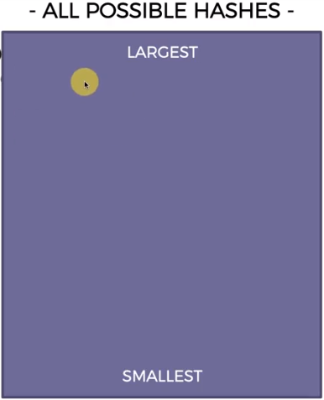
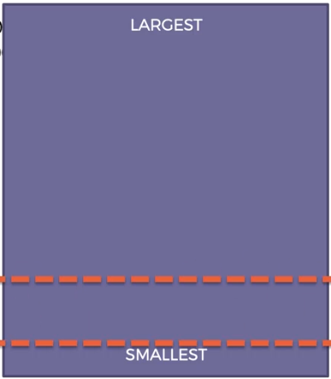
Max target = FFFFFFFFFFFFFFFFFFFFFFFFFFFFFFFFFFFFFFFFFFFFFFFFFFFFFFFFFFFFFFFF
So, intentionally they started with a difficulty that had 8 leading zeros.
Max target = 00000000FFFFFFFFFFFFFFFFFFFFFFFFFFFFFFFFFFFFFFFFFFFFFFFFFFFFFFFF
Current target = 000000000000000000FFFFFFFFFFFFFFFFFFFFFFFFFFFFFFFFFFFFFFFFFFFFFF

Slide 15
The difficulty tells us how its harder now to mine a bitcoin compared to what it was at the very start.
https://www.blockchain.com/btc/block/
https://www.blockchain.com/charts/difficulty
Difficulty is not adjusted by any central authority.
We know that this is a decentralized system and we know that there's no central authority and that therefore it gets adjusted by the nodes themselves.

Slide 16
As soon as the Bitcoin software is installed on your computer, the computer will be adjusting a difficulty on its own because that algorithm is coded into the Bitcoin protocol.
All the nodes are synchronized to adjust the difficulty every two weeks.
At the start, the difficulty was very low because nobody was mining Bitcoin and there was no need to change the difficult for a long time.
And then people started mining it more and more so as the mining power increases as more players join they start mining faster.
The mining power or the aggregate power is getting higher and higher.

Slide 17
And so the algorithm has to adjust the difficulty in order to keep that consistency of releasing a Block every 10 minutes in order to keep that consistent.
This is accomplished by changing the required number of leading zeroes every two weeks.
And that's keep it under control.
The whole swarm of miners and industrial level mining like organizations and mining pools as well is all under control by the same algorithm.

Slide 18

Bitcoin Mining One of the worlds largest Bitcoin Mines

Slide 19
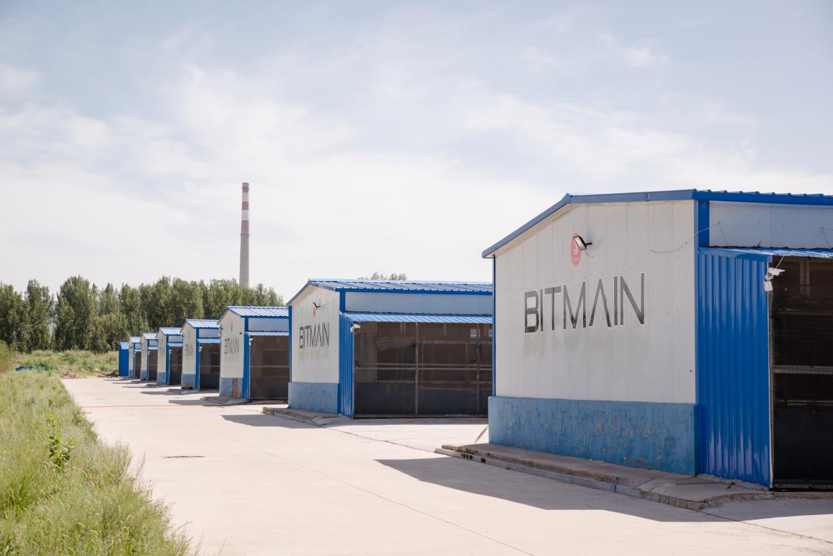

Slide 20
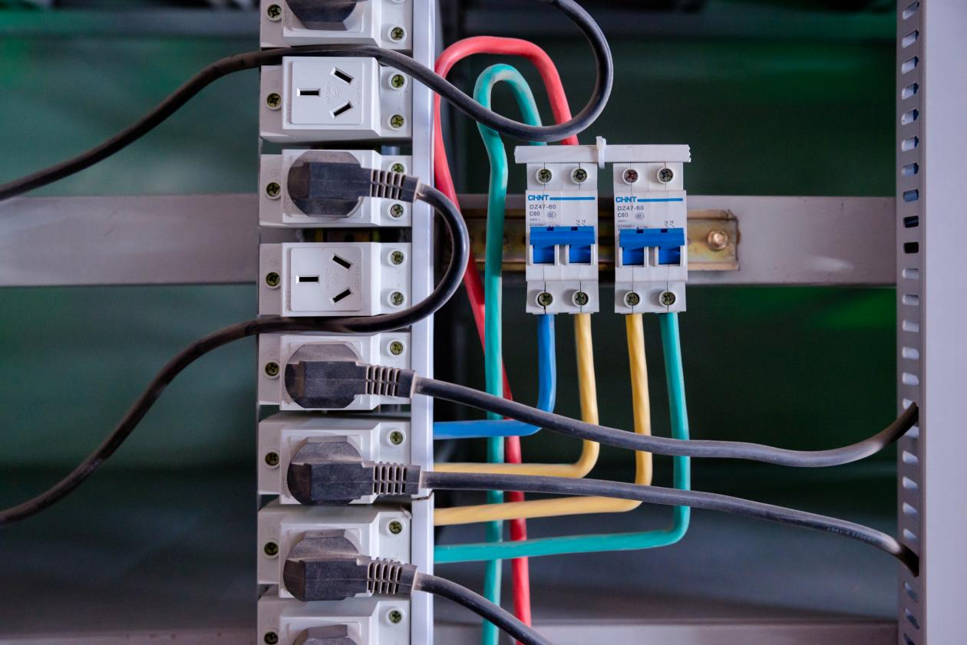

Slide 21
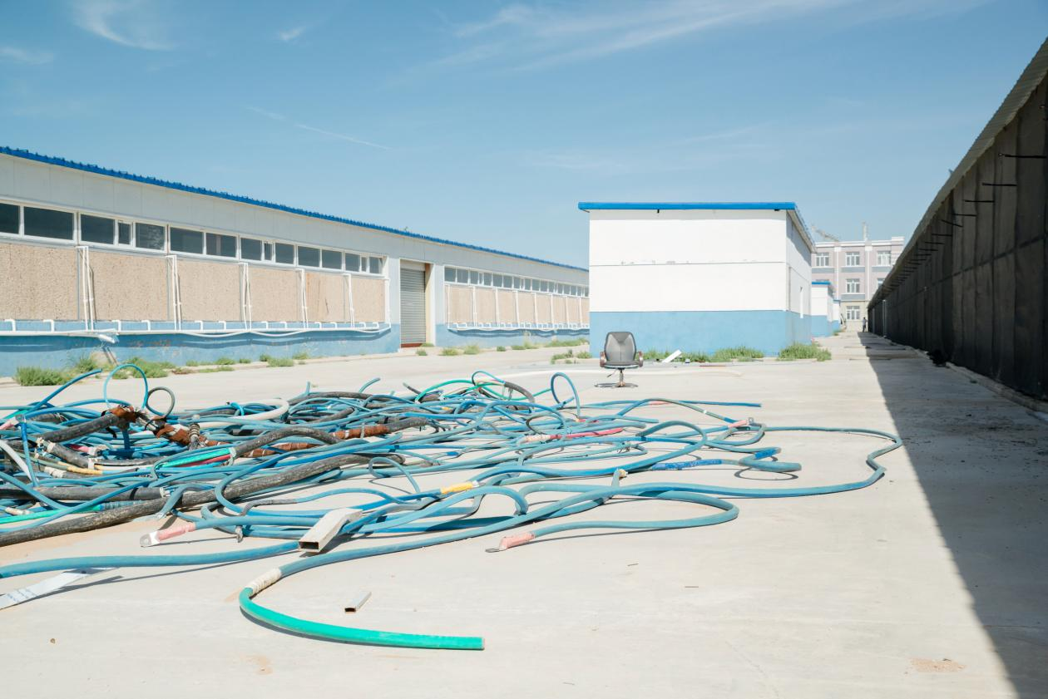

Slide 22


Slide 23
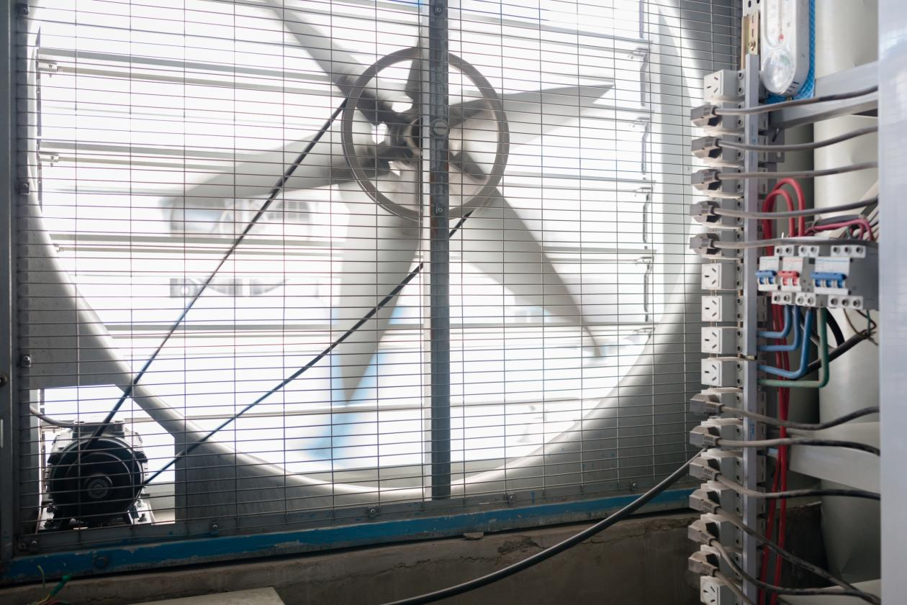

Slide 24
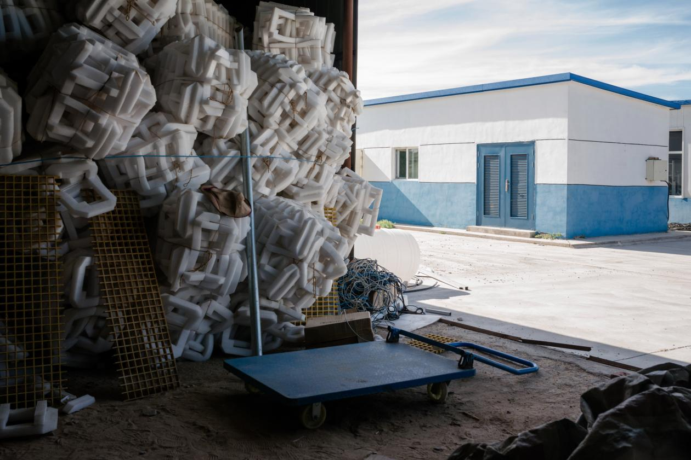

Slide 25
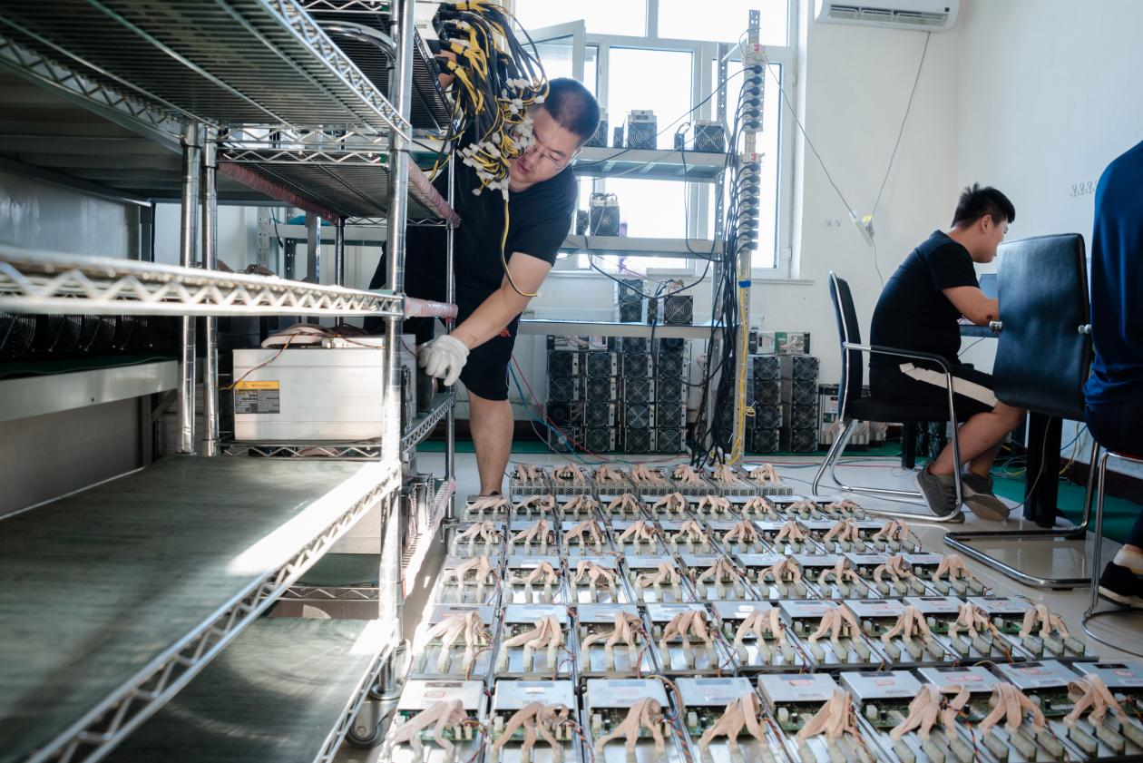

Slide 26


Slide 27
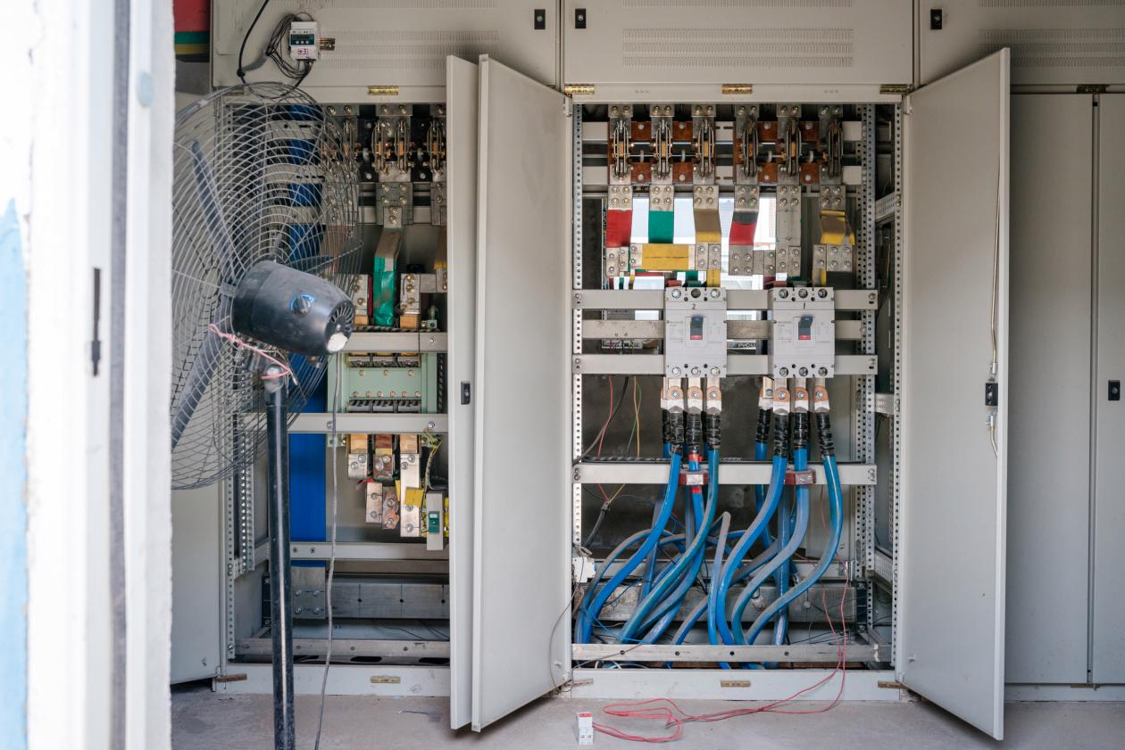

Slide 28
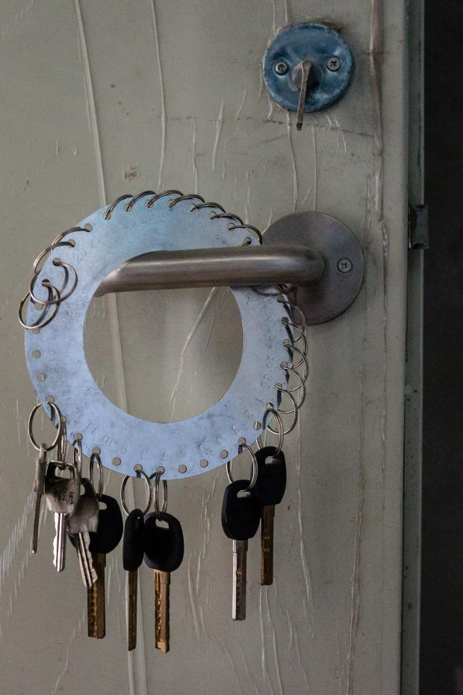

Slide 29


Slide 30


Slide 31
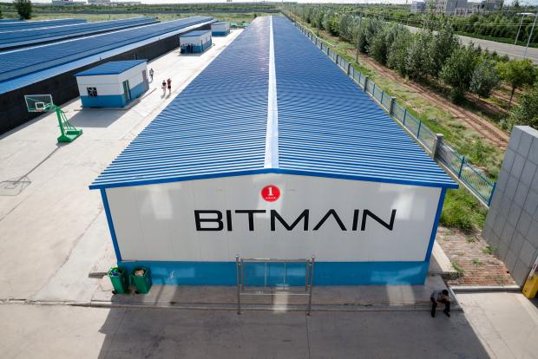

Slide 32
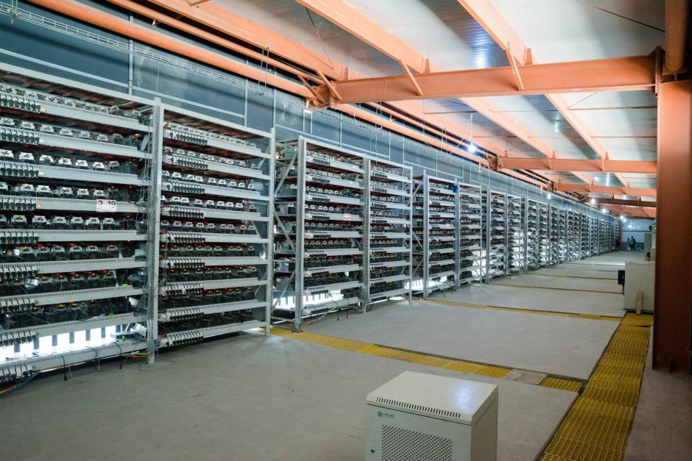

Slide 33


Slide 34
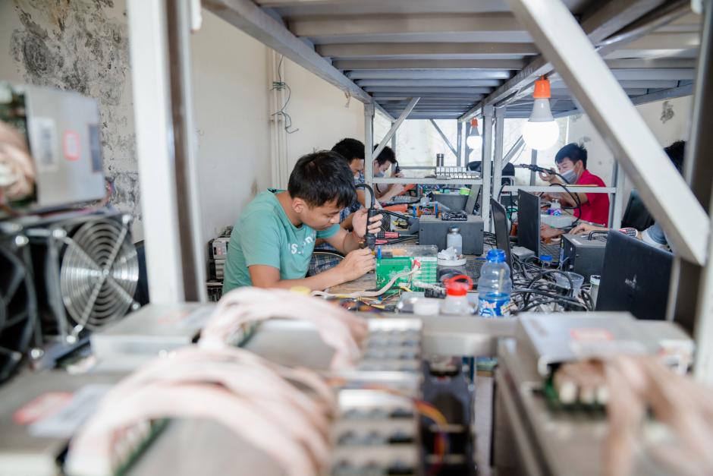

Slide 35


Slide 36
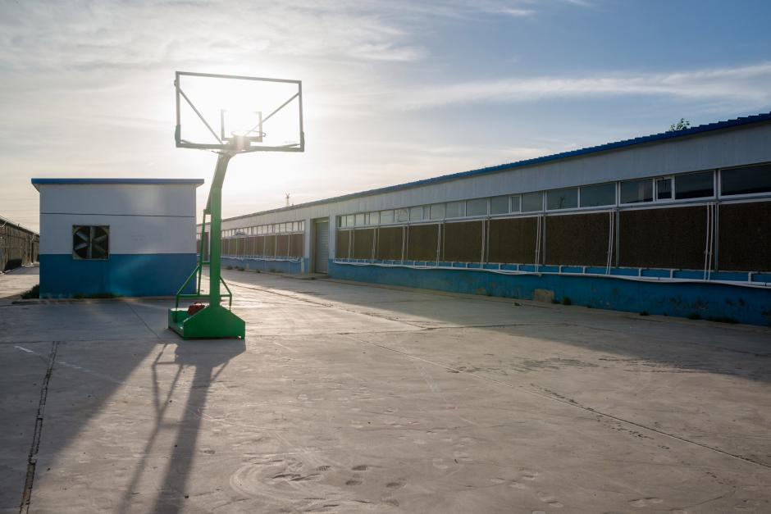

Slide 37
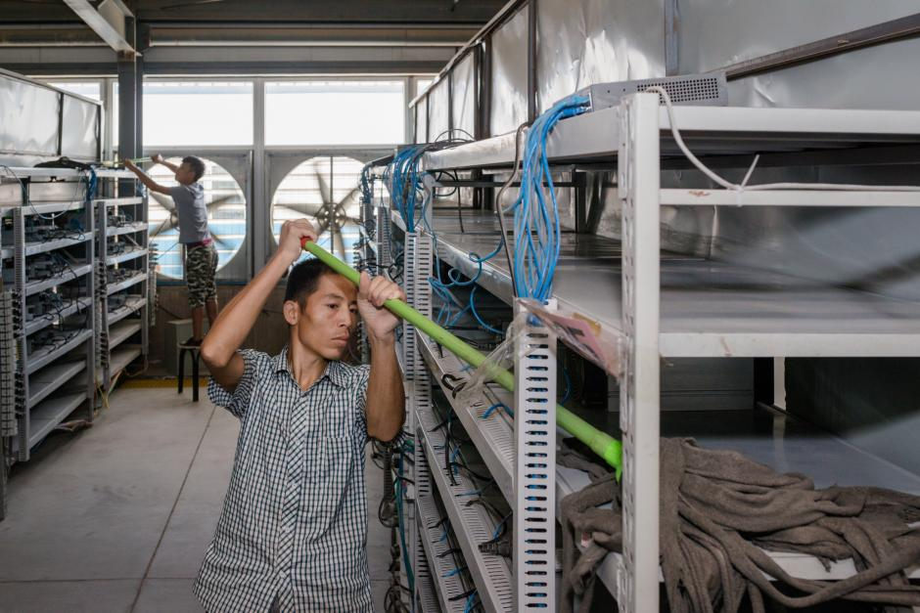

Slide 38
Mining Pools

Slide 39

A network of miners compete to solve the cryptographic puzzle.

Slide 40


Industrial Miners: are huge industrial size miners with huge computation power and big number of rigs who also join the network.
What If two of the small mining units were replaced by industrial ones.
In this case how someone with limited computation power can compete with the huge industrial units?? It seems unfair!!
The chances of small units for solving the cryptographic puzzle before the huge units is like 1 to million or one trillion, which is incredibly small possibility to find the golden Nonce.

Slide 42
Actually, Miners don't just mine for themselves; they enter mining pools.
These miners (inside the circles) combine their hashing power (computation power) into this mining pool.
So now all units in the pool have more mining power together.
The mining pool provides a service to distribute the work among the miners in such a way that they're not doing double work.

Slide 43
A very important service that a mining pool provides is it distributes the cryptographic puzzle among the miners.
So instead of simply brute forcing the nonce values till the golden nonce is found, the mining pool will distribute the possible nonce values among the members, for example:
Unit# 1 will try nonce values from 1-100,000.
Unit# 2 will try nonce values from 100,000-200,000.
And so on

Slide 44
This way no double work happens and finding the golden nonce will be faster.
As soon as one of them finds the golden nonce; this mining pool wins the reward and the fees for the that block.
Then, how the reward is split among them???
The reward will be split proportionally to the hashing power of each member.

Slide 45
The mining pools take a certain fee for what they're doing.
Mining pool is a web site or an organization where you can just go and download the software and install it and by this other units can join the pool.
Mining pools do not discriminate, anybody can join the pool including the big industrial size rigs.
A unit can switch between the different mining pools.

Slide 46
The more hash power the pool has the more players it has, which means the less portion of the fee the less portion of the reward you will get. it's kind of a tradeoff.
Another advantage for having mining pools is they completely remove the headache from individual miners.
What miners do is they just go and buy one of these mining hardware.

Slide 47
The user install it in his\her house, the user chooses a mining pool by visiting the corresponding web site, download the software and then that's it.
By installing the software, the user is pointing this mining rig which belongs to him\her (pointing its hash power) to the mining pool or to a number of mining pools and install the software and that redirects all of this computational power to that mining pool(s).
The user don't have to do anything, don't have to know how Bitcoins work, don't have to know what a block chain is.

Slide 48
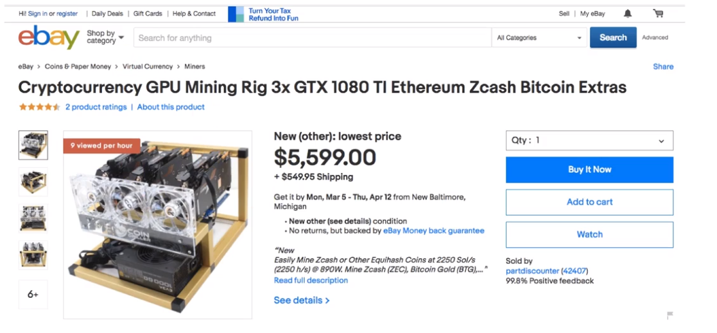

Slide 49
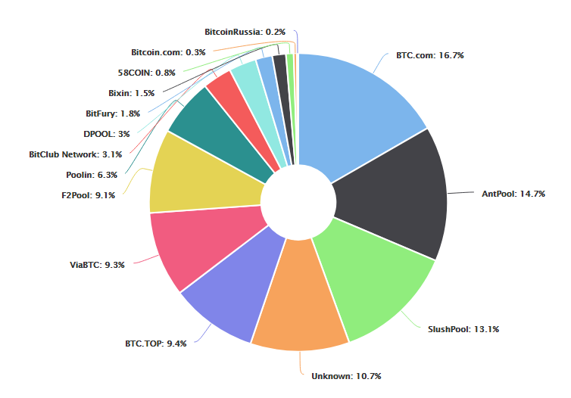
Hashrate Distribution An estimation of hashrate distribution amongst the largest mining pools
The graph below shows the market share of the most popular bitcoin mining pools. Not be 100% accurate

